Slide 1
Limitless Reach: Streamlining Virtual Injury Prevention Program Delivery for Widespread Implementation
Kristi L. Ladowski, MPH
Han Wang
Dunya Hamdan
Injury Prevention & Outreach Coordinator
Stony Brook University Hospital Trauma Center
Masters in Public Health Candidate
Stony Brook University
Masters in Public Health Candidate
Stony Brook University
June 2022
Notes:
Hello everyone. Thank you so much for taking the time to view our on-demand presentation. And a special thank you to the National Council on Aging for the opportunity to share our work. We are delighted to be a part of this year’s informative and inspiring conference. There is so much for us to learn and share with each other. So let’s get started. My name is Kristi Ladowski and I am the Injury Prevention and Outreach Coordinator for Stony Brook University Hospital which is based out of Long Island in NY. And I am delighted to introduce my co-presenters who just finished their Masters in Public Health programs in May. They are completing their final practicum requirements for graduation by working on projects related to this presentation. Hannah Wang has taking the lead on conducting data analysis and she will be presenting some of her results with your today. And Dunya Hamdan has been focusing on our data collection process to help us streamline everything moving forward.

Slide 2
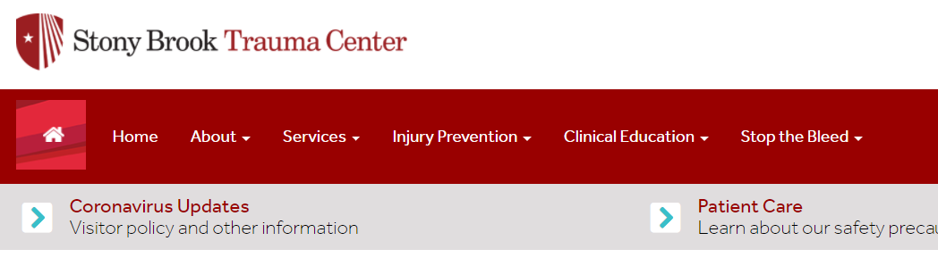
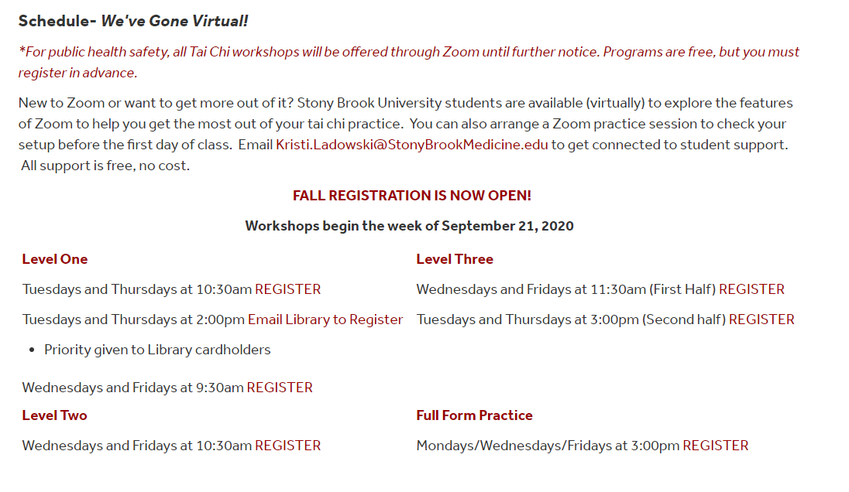

Our Journey through Virtual Delivery
Notes:
For today’s presentation, we’re going to take you through our journey in transitioning to virtual tai chi programs. It’s pretty amazing that pre-Covid, most of never imagined older adult falls prevention programs could successfully be delivered remotely. But 2 years later, it’s clear that remote and virtual program delivery is here to stay. So now our focus is on improving the user experience while streamlining administrative tasks and data collection.

Slide 3
How it Started…
Vs. How it’s Going
Presentation Outline
Pre-Covid Face-to-Face Program Summaries
Getting started (on the fly!)
Program Development and Implementation
Data Management
Results
Future Directions
Notes:
To provide you with a roadmap of this presentation, we’ll be starting with a brief summary of our pre-covid tai chi programs. This is meant to serve as a comparison for the virtual implementation later on. We’ll walk you through our process of getting started with virtual delivery and share where we’ve landed today as we’ve applied lesson learned along the way. We’ll share some of our challenges in electronic data collection and present some preliminary results. Finally, we’ll end with a brief mention of our future plans.

Slide 4
Definitions
Spring 2022 (Series)
Our Terminology for Tai Chi for Arthritis (TCA) Programming
T/Th 9am Part 1
Workshop = Tai Chi for Arthritis classes offered 2xs/week for ≥ 8 weeks
Level/Part = Identifies which TCA movements are being taught
Session = Specific workshop/level dates/times (i.e. T/Th 9am Part 1)
Series = Set of Sessions that are held concurrently
Completers = Participant attended minimum # of classes
Traditional 2/3 classes = at least 11 classes
Newer model = at least 16 classes
T/Th 10am Part 2
W/F 9am Part 3
W/F 10am 3-2/Full Form
Notes:
Before we move forward, I want to take a moment to go through some common terminology we’ll be using. We implement Dr. Paul Lam and the Tai Chi for Health Institute’s Tai Chi for Arthritis and Falls Prevention program. TCA for short. We refer to workshops as a set of TCA classes offered twice a week for at least 8 weeks. This maintains fidelity to the program. Tai chi is made up of a string of movements in particular order. Tai Chi for Arthritis breaks up their total movements into levels or parts so that participants can learn a subset of movements during a particular workshop. All participants should start with the basic or first level to learn the first set of movements. When they complete that workshop, they can then register for the next level or part as we call it to learn the next set of movements that get added on to the movements they already learned. We’ll touch on this again shortly. We can think of a session as the name or description of the workshop level and the days and times it is offered. For example, a series would be the T/TH part 1 workshop. So we know in this workshop, participants will learn the part 1 movements and classes will be held t/th at 9am. Finally. A series is a set of sessions or workshops all held concurrently. Using the diagram on the right, you can see the Spring 2022 series that runs 10 weeks from Feb to April has 4 series occurring at the same time. You’ll see this more clearly demonstrated in future slides.
We will also be focusing on program completion. This is a rough estimate to let us know how many participants attended enough classes for us to presume they received an effective quote/unquote dose to achieve the expected outcomes. In this case, reduced fall risk. Traditionally, the Administration for Community Living describes a completer as a participant who attended at least 2/3 of the classes in an evidence-based workshop. So when we started implementing TCA back in 2015, our guidance from our State grant holder was that completers were participants who attended at least 11 of 16 classes. Since the TCA program was originally designed to be delivered in 16 classes, ideally twice a week for 8 weeks. But we have received new guidance from our State grant holder that completers of TCA are more recently classified as participants who attend at at least 16 classes in a workshop. So to achieve this new requirement, we’ve been adding additional classes to workshop to allow for greater attendance and completion under the new standard. So we extended the workshops to be longer than 8 weeks. We will be showing both completion results in our presentation today.

Slide 5
Pre-COVID Face to Face Workshop Delivery
Notes:
We wanted to share some basic reporting from our pre-covid TCA programs to serve as a reference when we begin talking about our virtual TCA programs.

Slide 6
Face-To-Face Tai Chi for Arthritis (TCA)
Suffolk County, NY
“Pop-Up” & Permanent Locations
Libraries
Senior Centers
Faith-Based Organizations
Multiple Workshop Levels
Part 1 (TCA Basic 1-6)
Part 2 (TCA Advanced/Extension 7-12)
Part 3-1 (First half of TCA Part 2)
Part 3-2 (Second half of TCA Part 2)
Full Form Practice
Notes:
Our hospital is located in Suffolk County, NY. Home to a little over 1.5 million residents, of which about 17%, or 255,000, are older adults. And of course, older adult falls are the leading cause of injury related hospitalization for us. We partnered with our Suffolk County Department of Health to have a few TCA instructors offering workshops throughout our County. Originally, we would schedule what we could call “pop up” sites meaning that we would offer one workshop there and then move on to a new site afterwards. As we went on, we would receive more and more requests to offer the higher-level workshops so that participants could continue to learn more tai chi and stay engaged in the program. So this led to some locations becoming more permanent sites. One of our highlights was a partnership with the North Short Jewish Center that would host ongoing workshops at their site. We offered the program for free, but asked participants to make a small donation to the Jewish Center since we were using their space. AT this site, we began offering what started calling the series of workshops. We would offer all 4 levels of the program concurrently, typically back to back on 2 days /week. And when one series ended, the next one began a few weeks later. This allowed us to build up a referral process where people heard about the program held at this one location, and if they missed the start of a series, they could enroll in the next one starting soon. And we continued to offer the pop up sites to engage new participants through the County. So now I’ll pass it over to Hannah, who will go through some of her results from analyzing the data we collected from these in-person workshops.

Slide 7
Completion Rate of In-Person Workshops
Pre-Covid 2015-2019: 64 Workshops and >1,000 participants
Program Completion Rate (n=1045)
Completion | Traditional ACL 2/3 Attendance Completer (≥11/16 classes) | New Standard of 16 Attendance to be a Completer (≥16 classes)
Tai Chi Beginner (n=593) | 51.78% | 10.32%
Tai Chi Advanced (n=452) | 56.19% | 9.29%
Notes:
Thank you Kristi. I’m going to share findings on completion rate of in person workshops. From 2015-2019, there were 64 workshops held reaching over 1000 participants. Program completion rate is calculated based on their attendance. Tai chi classes are offered in different levels. The Tai Chi beginner is all of the part 1 workshops. The Tai Chi Advanced is all of the higher levels. We make this distinction because we would expect people taking the program for the first time to be different than individuals who have already participated in a beginner level and are choosing to continue in more workshops.
The In-person Tai chi workshops had 16 classes in total; if participants attend 11 or more classes, they are considered a completer using the traditional standard of two-thirds of classes attended. We are also showing the newer standard of requiring 16 attended classes to be a completer. Among 1045 participants, there are 6 people who registered but never attended a class.
The completion percentages are shown in the table. As you can see, when we used the 11 class attendance, there is a little over 50% completion. When we use the 16 class standard, it drops to about 10%. Interestingly, there is not much difference between the beginner and advanced completion percentages. So even though the advanced participants are truly invested in tai chi and want to continue the program, life is still getting in the way of attending all of the classes. This is very informative for our program delivery. We know many beginner participants drop out because tai chi is not the right fit for them. But the advanced folks still have barriers to attending all the sessions even though they really enjoy the program.

Slide 8
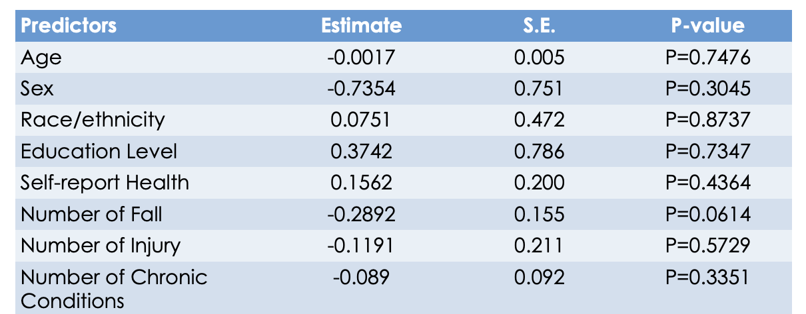
Association between Completion Rate and Predictors
Notes:
We also have data from the Administration for Community Living’s pre and post surveys. We were interested in seeing if completion status was associated with participant characteristics. To do this, we performed a logistic regression. The program completion status was the outcome and select demographic characteristics were the independent variables. The results tell us if there are any characteristics that are associated with completion status. We used the greater 16 class attendance for the completer status.
The positive estimates tell us that those participants were more likely to be completers. Self reporting as White, completing college, and being in good health were all positively associated with completing the program. The negative estimates tell us that the participants reporting those variables were less likely to complete the program. Participants reporting older age, male, falling in the last 3 months, falling with injury, and having more chronic conditions were less likely to be completers.

Slide 9
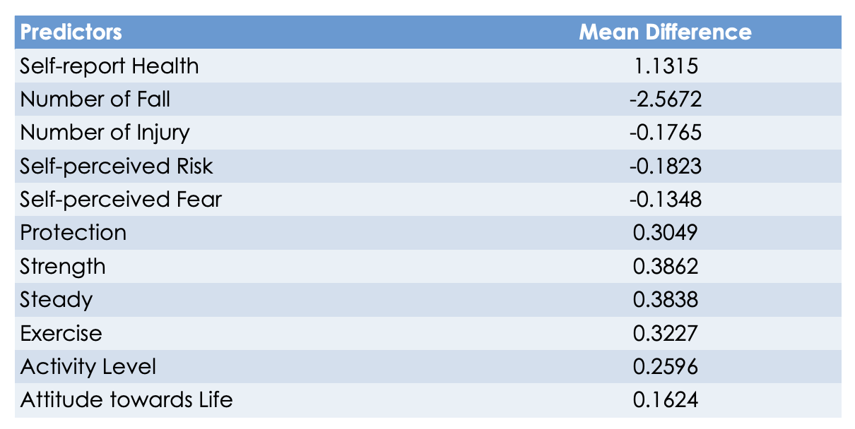
Program Impacts
Notes:
For the purpose of program evaluation, we ran a paired sample t-test to determine the program impact. The pre/post survey responses were compared to evaluate the mean difference reported by each participant before and after the program. We observed improvement in health status, protection against falling, strength, steadiness, exercise, activity levels, and overall attitudes towards life. There was a decrease in the number of falls, falls with injury, and self-perceived risk and fear of falling.
It is important to note we did not have post surveys for more than 50% of the participants because they did not complete the workshops. And none of the differences in pre/post scores were statistically significant. But overall, the results show a positive trend for the program impact.
And now I’ll pass it back to Kristi.

Slide 10
COVID March 2020
Notes:
Thank you Hannah. So now that you have a sense of what we were doing pre-covid, let’s get into the meat of our presentation today.

Slide 11
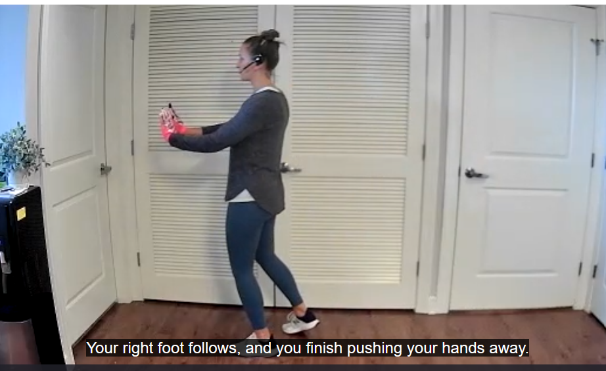
Getting Started
NY Pause March 15, 2020
New workshops started March 11, 2020
In-person -> Zoom (from my living room)
Practice the movements already taught in-person
Thought it was a temporary 2-week arrangement…boy were we wrong!
Requests for more/new movements
Looks like we’ll be doing this for awhile…
Notes:
We of course were not unique in that all of our community programs were halted due to Covid. We were launching a new series of workshops at the North Shore Jewish Center the week before NY Pause went into effect. So to engage with our registered participants, for what we thought was going to be a few weeks, we offered to hold Zoom classes to review the movements they have already learned. This was meant to be a few weeks of practice before we could get back to in-person. Well, we soon found out that the pause was not going to be lifted anytime soon. And the participants eagerly began requesting to learn the new movements. The planning was a whirlwind and the details are quite fuzzy, but somehow we were ready to launch our first official TCA Summer 2020 series the week of June 22nd. It was made up of 6 series, 3 part 1s and then 1 of each higher level. I’ll next walk you through some of the aspects that went into the planning, lessons we learned along the way, and wat our program delivery looks like at this current time.

Slide 12




Considerations for Going Virtual
Visit NCOA’s Resources for Remote Delivery
Do you have the technical capacity?
What virtual platform will you use?
Do you have an appropriate space?
Are you able to provide quality information?
Notes:
I would be remiss to not mention NCOAs wonderful library of recourses on their website for remote program delivery. While we were figuring things out here on long island, folks across the US were doing the same thing. Thankfully, people were willing to share lessons learned and put on webinars by late summer 2020. And of course, NCOA became a lead organization in gathering all these amazing resources for us as program implementers. So this part of the presentation is meant to share some of the lessons learned we picked up along the way both from personal experience and from our colleagues through the US. These lessons learned are what go us to our current state of program delivery.

Slide 13
Safety Considerations
Before Workshops
During Workshops
Is there a physical component that carries an inherent risk?
Are there special considerations for physical/mental/medical conditions?
Will you screen individuals in advance?
Questionnaire? Physical Assessment?
Will you collect consent forms?
If yes, how? Electronic, verbal, mailed…
Should you collect ICE info?
If yes, how and when?
Do you need support staff to actively watch participants while you teach?
Will they be paid or volunteer?
What qualifications are needed?
Do you want participants to give signals or notification when walking away from screen?
Thumbs up signal, verbal announcement, chat box…
How will you “read” the room virtually?
Breaks, discussions…
Low vision, seated…
Notes:
We all take safety very seriously. So how to we prevent and also plan for the worse case scenario when we are not in the same physical space as our participants? I’m not going to go through everything listed on this slide. But instead, share what we’ve been doing. Because we are enrolling so many participants at once, we do not have the manpower to individually screen each person. And it’s not necessary for TCA. TCA was specifically designed to be safe and effective for anyone. So there were many safety aspects inherently embedded into the TCA teaching techniques and not much we needed to modify. What we did have to figure out was how to collect in case of emergency contact info and how to better read the room for safety cues.
We first collected in case of emergency info and consent as a separate survey form. This required keeping track of who is registered and who completed the forms. This was also the time when Zoom bombing was quite frequent. To prevent Zoom bombing, we required registration in Zoom in order to receive the class link. So participants had to provide a valid email address to get the class link. And I connected with our University’s teaching support and found out we could modify the Zoom registration questions in order to embed the collection of the in case of emergency contact info and consent. So anyone who registers is required to provide all this information in zoom before receiving their class link. This has been a huge help for us.
And for the in-class safety supervision, we brought on tech support students using Federal Work Study positions. Which I’ll speak about in more detail very soon. The instructors also attended each others' classes early on so we could learn from each other’s techniques and learn how to read the room. We now encourage new instructors to do the same.

Slide 14




Recruitment
How will you advertise?
How will you reach your target audience?
What is your max group size?
Will you have a waitlist or add more sessions?
Who will create advertising materials?
Notes:
Our recruitment has highly been from word of mouth. We also created flyers and we engage in other promotional activities when a new series is getting ready to launch. Since most people became familiar with QR codes during the pandemic, we added it to our flyer which sends people directly to the website with information on how to register for a new series or to be added to our waitlist. So we have very much moved away from phone call enrollment to everything living on our website. This has reduced the burden of administrative tasks, but it does lose that human connection. So everything is a tradeoff and it’s a matter of determining what works best for you.
As far as class size goes, we were very cautious at first. And limited the class enrollment to about 35 people. But we immediately learned that many people register through the website, but never actually attend a class. So we over enroll knowing people will not show.

Slide 15




Registration & Data Collection
How will you collect information?
How will your participants register?
Website, survey, phone, email, site host (library)…
What basic data do you need collect?
Contact info, surveys…
How will you collect the data?
Online survey, mailed…
How will you manage the data?
One vs. Multiple Databases
Notes:
So this has probably been our biggest challenge. We streamlined all of our registration and data collection using the website and electric data capture applications such as Qualtrics and Zoom itself. But we have encountered a lot of challenges in how to manage the data. This is something I’ll speak about more in a few slides.

Slide 16

Program Development
Enhancing Virtual Delivery to Plan for Long-Term Implementation
Equipment
Small Grant for instructor microphones and Webcams
Website
Online registration and surveys
Includes information about other falls prevention programs
Recruitment
Partner with libraries
Emailed past participants
Created flyers
Session “0” for first time tai chi participants
Replaced with 1-pager
Notes:
When we first started, we knew we needed some basic technology resources. The timing worked perfectly for us to apply for a small grant through our NYS American Trauma Society Chapter to purchase webcams and headset mics for all our partner instructors. And because we collect emails for all participants, it makes it very easy to maintain contact lists. Back in 2020, many participants were still getting familiar with Zoom. So we relied more heavily on a session 0 to give participants time to practice logging in and asking questions. But as time went on, maybe 1-3 people would continue to show up for these session 0s. We discovered most older adults were now comfortable using Zoom and we instead created a 1 page “what to expect” document to email participants before each class. But we still offer one-on-one support for any requesting it.

Slide 17

Maintaining Partnerships
Multiple Instructors
Ease into virtual teaching
Practice with another instructor first
Safety
Second pair of eyes
Maintain ability to offer multiple levels
Increase Reach
Continue to Engage Participants
Coverage
Sitting & Standing Views
Trouble shooting
Notes:
Our partnerships have been the bedrock of our program success. No one can do it alone. Prior to COVID, we were already partnering with our County Department of Health to collaborate on the tai chi program delivery. So much of what we do now in the virtual delivery already existed with the in-person. We encourage new instructors to attend experienced instructors' classes. This helps get new instructors more confident in their teaching and we’ve just found it incredibly helpful to learn from each other’s style of teaching. We also help cover each other classes since this is a long-term commitment. As instructors, being able to lean on each other, trouble shoot, and share general tai chi updates has made us better practioners and instructors. I’m really proud of the quality of TCA program we are able to deliver because the instructors truly love tai chi and are invested in personal growth. It’s not just a physical activity program, we created tai chi families and fee a real connection with our participants even though we’ve never met most of them in-person.

Slide 18
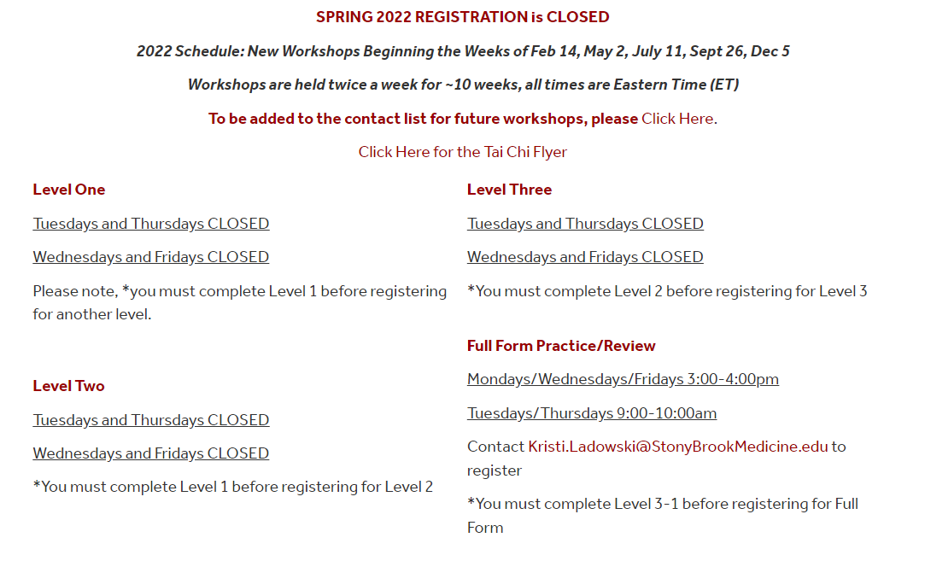
Program Implementation
Streaming for Long-Term Delivery
Schedules
Series every 10-12 weeks
2 Workshops Levels on varying days/times
Part 1 W/F 4pm
Part 1 T/Th 10am
Levels Progress in Time Slots
Objectives
Increase Participation
Increase Completion Rates
Notes:
So here’s where we’ve settled. To meet the 16 class attendance requirement for completion status, we extended the length of the workshops by a few weeks. We look at the full calendar year, taking into account important holiday observances, and schedule so that when one series ends, the next one begins. Our hope is that participants will remain engaged throughout and not worry as much when they need to miss a day. We still typically only teach for about 8 weeks. But the extra few weeks allow us time to review the movements, explore the depths of the tai chi program and further connect with the participants. It has been very well received. We’ve also settled into timeslots for the sessions. So we hold sessions in the mornings and late afternoons. And then we alternate the levels so if a Part 1 is offered on a W/F afternoon, the other Part 1 is on a T/Th morning. That way the participants can mix and match mornings and afternoons or just take all of them. Finally, the specific timeslots will advance through each subsequent series. So if someone takes a Part 1 T/Th 10am, when that series completes the T/Th 10am time will turn into the Part 2 in the next series. The participants have given us great feedback on this setup because they can keep a consistent schedule through the year. And the instructors know that we are individually committed to our specific days/times for the entire year. For example, I teach the T/Th 3pm and 4pm time slots no matter what level it is. And I know that other instructors can cover classes for me as needed. Overall, we feel like this implementation design will help increase participant and completion rates with the flexibility of class times. But we will continue to assess as we move forward.

Slide 19
Program Implementation
Enhancing the Participant Experience
Zoom Features
Screen Share Music
Spotlight
Closed Captioning
Recordings
Mini Class Recordings
Dr. Lam Videos
Year-Round Schedule
Constant engagement
Simplifies advertising
Removed Geographic Boundaries
Refer Friends/Family
Participate when traveling
Notes:
A few other notes on aspects we’ve applied to improve the overall participant satisfaction. We try to stay up to date on new Zoom features. We can share the music through the advance screen share feature with audio only. And spotlighting and closed captioning help participants better see and understand the instructors. We don’t record our full class time. That’s what the DVDs are for. Plus we want the participants to feel comfortable engaging and asking questions throughout the class. So instead, we record mini segments during class so that it is only the instructor on the video. We can make the videos by request whenever the participants feel like they need something for review and practice outside of class time. And as we get to the final few weeks of class, we often screen share some of the Dr. Lam videos so the participants can see him and his instructors doing the same movements and we have discussions about what they notice. This again helps us deepen the participant's understanding of tai chi principles for added benefit. In the last slide we spoke briefly about the year-round scheduling. Another benefit is for advertising and recruiting. If someone missed a series start date, they will know exactly when the next one will begin. And finally, being on Zoom has removed geographic barriers. So we reach a broader audience and our participants are eager to share the program info with family and friends.They also take us traveling with them.

Slide 20

Program Implementation
Student Technology Support Positions
Federal Work Study Program
Federally Funded
Supports student financial aid
Job Skill Development
Safety
Eyes on screen
Logistics
Attendance
Live Tech Support
One-On-One Tech Support
Notes:
When we talk about our Zoom tai chi programs with other implementation sites, the Student Technology Support positions tend to gage a lot of folk's interest. Through our University’s Career Center, we created a Zoom Tech support position. It was a huge win-win early in the pandemic when all the students were taking classes remotely and could not secure in-person work. Many students receive Federal Work Study grants as part of their financial aid packages. They need to be hired in a federal work study position to earn paychecks until their balance runs out. Federal Work Study funds come from the government and there is no cost to our department to hire the students. The students get to work from anywhere and it’s a low stress job for them. They are an incredible support for both in-person workshops and other logistical tasks. There is a small gap between the end of the May semester and July 1 when they can’t work. And I sorely miss them during that time since I need to make up for it. It is incredible how helpful it is to have them as tech support. And they’re really good at trouble shooting when participants have zoom issues.

Slide 21
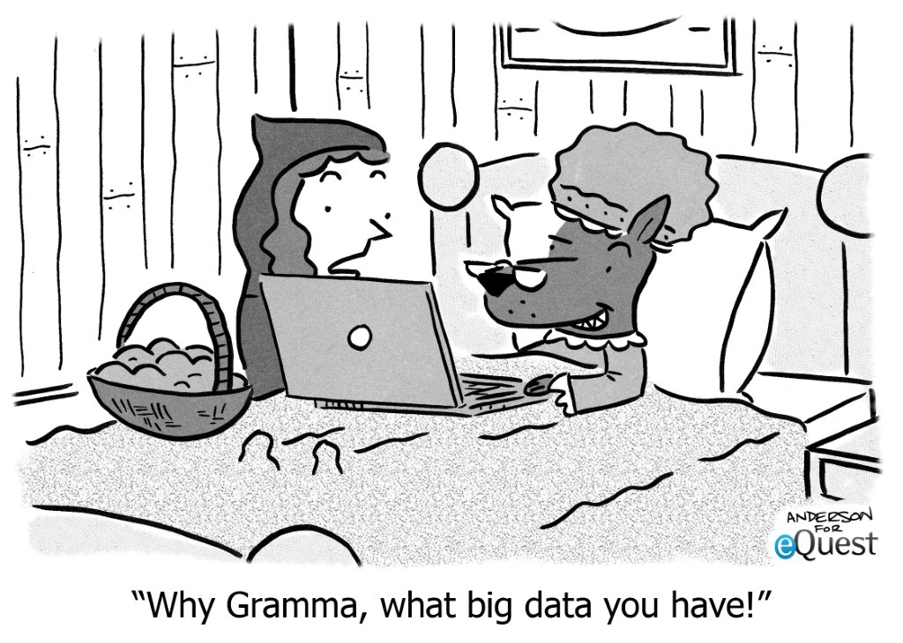
Data Management
Transition to Electronic Data Collection
Notes:
So that was a lot about our successful program implementation. Now comes the ongoing challenges we are facing with data collection and management.

Slide 22
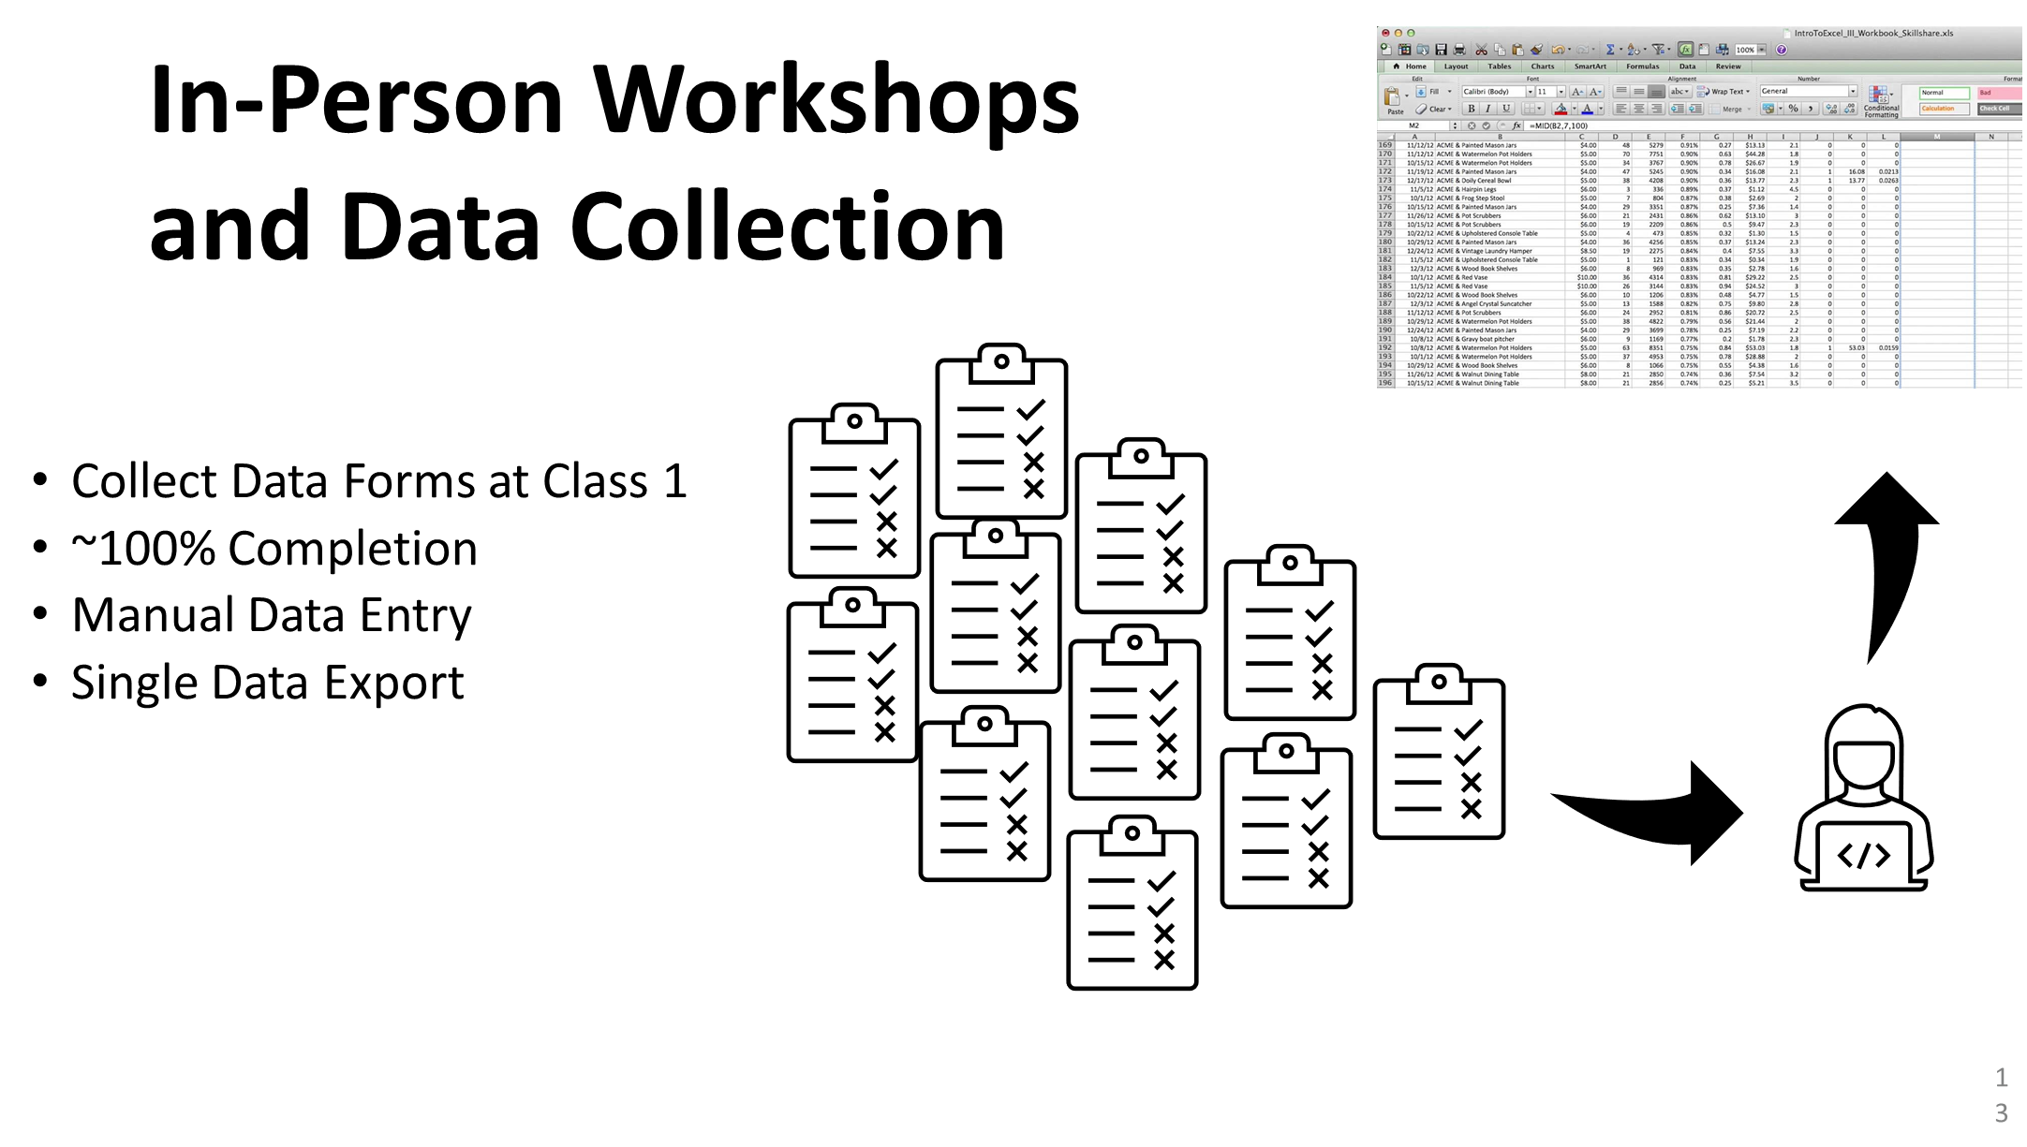
Notes:
When workshops were face-to-face, we would collect all the surveys and attendance with pen/paper
Then volunteers would manually enter all the data in a database
Pros: All data easily exported into one excel sheet to be analyzed, Which Hannah showed earlier in the presentation. And we have nearly 100% survey pre-surveys completion because we took time during the first class to ask participants to fill out the forms.
On the downside, this was time consuming to transition the pen and paper to electronic which causes delays in data analysis. And it’s susceptible to data entry mistakes.

Slide 23
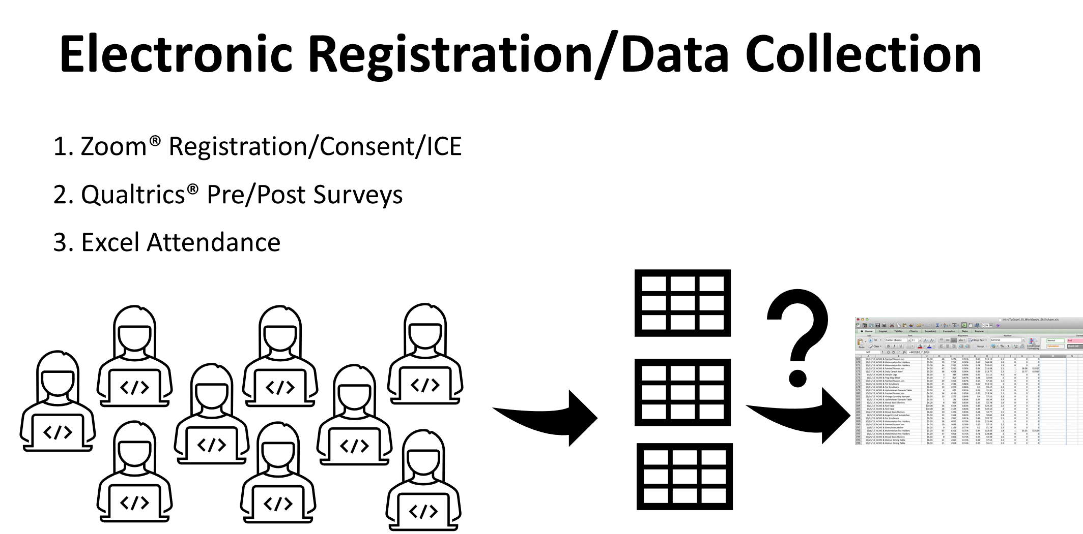
Notes:
With the virtual delivery, all of the forms and surveys are completed electronically by the participants. Sounds simple, but boy is it not. All of the participants are independently filling out their registration in Zoom and surveys in Qualtrics. Then we take their attendance in excel. This creates 3 separate data reports that need to be merged. So we first had to figure out how to give a unique identifier because hand typed emails and codes for surveys created merging problems in the statistical software. And with hundreds of participants in each series, this is not something we want to be doing by hand. So we are actively seeking some solutions with out Health Informatics Department at the University.

Slide 24
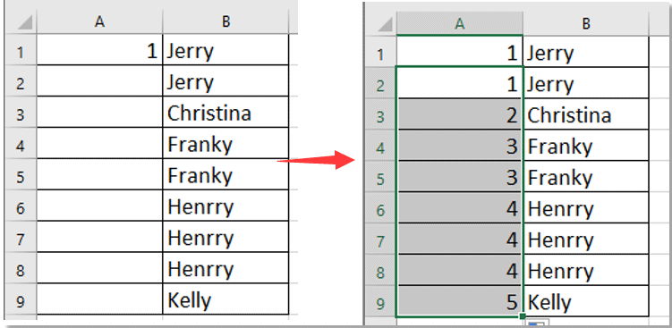
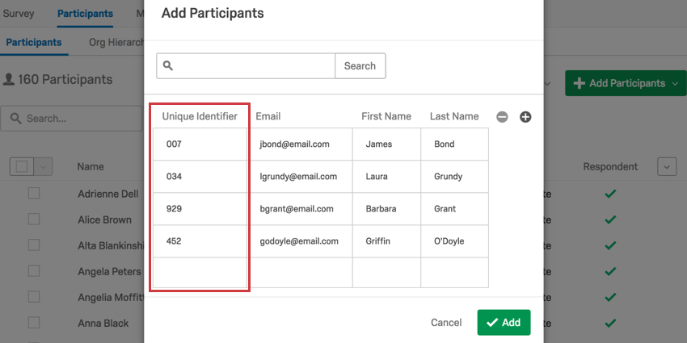

Unique Identifier
REGISTRATION/ATTENDANCE
QUALTRICS SURVEYS
Notes:
While we seek to find a better solution, We started using the registration reports to assign a unique ID, which also appears ont heir attendance. That way all 3 data reports have a unique ID to merge registration/demographic data with attendance and survey results
And we need to make sure that a truly unique participant in multiple sessions has the same unique ID so it can be properly accounted for in the data analysis. We can then upload the participant emails with their unique IDs directly into Qualtrics to send out the survey links. This allows Qualtrics to track participant survey responses by Unique ID. And we can also send gentle reminders to those who did not complete the survey. This process has definitely increased our survey Reponses rates to about 60%. Much better than the early Reponses rates of around 20%. But again, we’re still a work in progress. And now I’ll pass it back to Hannah again to share some of her virtual tai chi results.

Slide 25
Preliminary Results of Virtual TCA

Slide 26
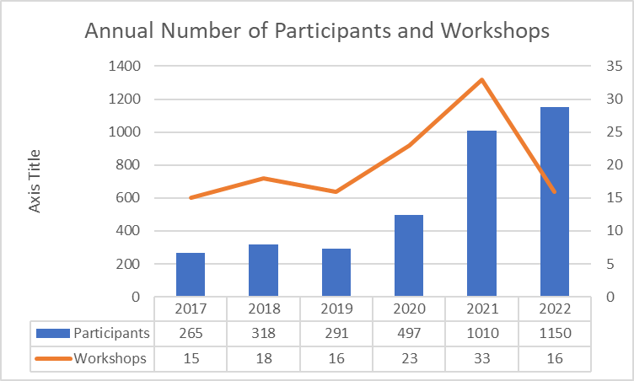
Reach
Face to Face vs. Virtual

Slide 27
Sample Demographics
Spring 2022
Demographic Variables by Level (n=242)
Variable | Total (n=242) | Part 1 (n=115) | Part 2 (n=43) | Part 3 (n=20) | Part 3-2/Full Form (n=64)
Avg Age (years) |  | 69.7 | 71.4 | 71.5 | 71.8
Referred by Clinician? (% yes) | 12.0% | 10.40% | 9.30% | 25% | 12.50%
Male (%) | 12.0% | 13.90% | 9.30% | 10.00% | 10.90%
Hispanic (yes %) | 3.3% | 5.20% | 2.30% | 0% | 1.56%
White (yes %) | 79.8% | 80.00% | 83.70% | 60.00% | 82.80%
College Graduate (yes %) | 83.1% | 85% | 79.10% | 80.00% | 82.80%
Live Alone (yes %) | 25.2% | 27.00% | 11.60% | 50% | 23.40%
Fallen Past 3 Months (yes %) | 22% | 19.30% | 27.90% | 30.00% | 20.30%
Bolded = significant difference between levels (p<0.05)

Slide 28
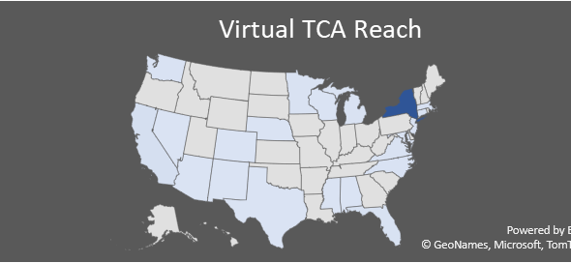
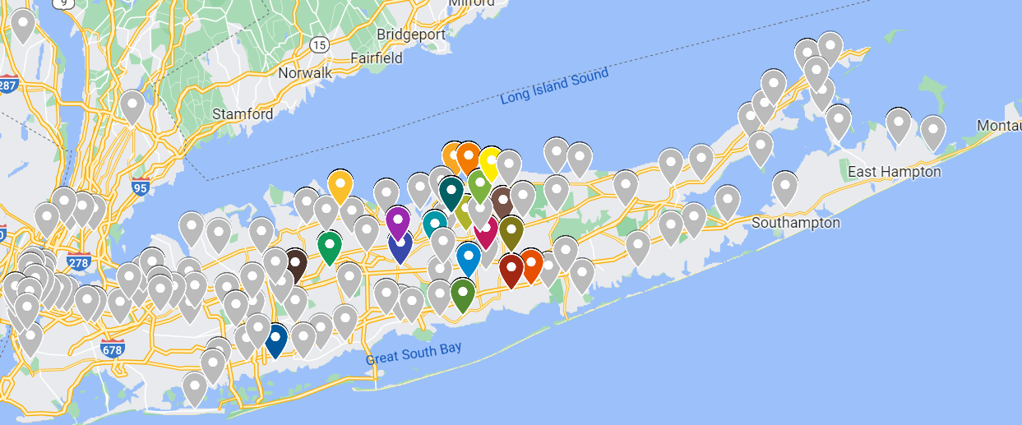

Virtual Tai Chi Reach
Spring 2022
Word of Mouth!

Slide 29
Virtual TCA Completion Results
Notes:
Thank you Kristi. So most of our virtual data did not have unique IDs. So for Summer 2020 through Winter 2021, we create unique IDs using the participants email addresses. It takes hours of coding to create the unique IDs and merge all the different files for each workshop series. So for now, I will be presenting on some select workshops series. But our goal is to not only analyze each individual round of workshop series, but to eventually combine all the virtual data into an aggregate form to see overall trends.

Slide 30
Fall 2021 Workshops
Program Completion Rate (n=491)
Completion | Traditional ACL 2/3 Attendance Completer (≥11/16 classes) | New Standard of 16 Attendance to be a Completer (≥16 classes)
Overall (n=491) | 166 Completers (33.81%) | 56 Completers (11.40%)
Part 1 (n=147) | 44 Completers (29.93%) | 6 Completers (4.08%)
Part 2 (n=62) | 23 Completers (37.10%) | 4 Completers (6.45%)
Part 3_1 (n=59) | 30 Completers (50.85%) | 8 Completers (13.56%)
Part 3_2 (n=116) | 69 Completers (59.48%) | 35 Completers (30.17%)
Notes:
We’ll first look at our Fall 2021 Series of Workshops. We offered 2 series for each level, for a total of 8 series. Across all 8 series, we had 491 participants attend at least 1 class. Based on the 11 class minimum, about one third of participants completed the program. With the 16 class minimum, 11.40% of participants were completers. And you can see the breakdown of how many participants completed each level. You can see the proportion of completers increases in the higher levels as we would expect.
We can see from these results that completion in the virtual Part 1 is much less than the in-person we showed you earlier. We expect this is because it’s less of a commitment up front to attend virtually as opposed to in-person. Also that people are just a box on a screen when they first start and maybe don’t feel that connection upfront like they do in-person. And maybe people just don’t like learning tai chi on Zoom even though they wanted to give it a try.
It’s important to note that in this series we were offering optional practice sessions after the series ended. To try and increase the overall attendance, we invited partipcants to join practice sessions to review the movements they had learned during the series. So this series included the 16 classes plus 3 weeks of optional practice sessions over the Thanksgiving holiday.

Slide 31
Fall 2021: Relationship between Number of Session Registered and Completion Rate
Number of Sessions | Traditional ACL 2/3 Attendance Completer (≥11/16 classes) | New Standard of 16 Attendance to be a Completer (≥16 classes)
1 (n=285) | 51 Completers (17.89%) | 14 Completers (4.91%)
2 (n=109) | 43 Completers (39.45%) | 22 Completers (20.2%)
3 (n=17) | 8 Completers (47.1%) | 8 Completers (47.1%)
4 (n=18) | 8 Completers (44.44%) | 4 Completers (22.2%)
5 (n=1) | 0 Completers (0%) | 0 Completers (0%)
8 (n=6) | 4 Completers (66.7%) | 4 Completers (66.7%)
2+ (n=151) | 63 Completers (41.72%) | 38 Completers (25.17%)
Notes:
This slide is taking a look at the Relationship between Number of Session Registered and Completion Rate. If we look at row 1, there were 285 participants who registered for only one session, regardless of which level it was. So for participants who only registered for 1 session, 17.89% attended at least 11 classes and 4.91% attended at least 16 classes. You can see the same results in the following rows if the attended 2 sessions, 3 sessions, and so on. The bottom row adds all the participants who attended more than one session. We can see that overall, the completion rates for participants registering for more than one session was more than double that of participants who attended only one series. This supports our idea that allowing participants to join multiple sessions allows them more options to attend class and improve their overall attendance.

Slide 32
Winter 2021 Workshops
Program Completion Rate (n=442)
Completion | Traditional ACL 2/3 Attendance Completer (≥11/16 classes) | New Standard of 16 Attendance to be a Completer (≥16 classes)
Overall (n=442) | 146 Completers (33.03%) | 81 Completers (15.61%)
Part 1 (n=177) | 36 Completers (20.34%) | 19 Completers (10.73%)
Part 2 (n=78) | 32 Completers (41.03%) | 12 Completers (15.38%)
Part 3_1 (n=50) | 20 Completers (40%) | 8 Completers (16%)
Part 3_2 (n=137) | 58 Completers (42.34%) | 30 Completers (21.90%)
Notes:
We did a similar analysis of the Winter 2021 series. We can see the completion rates have increased a little compared to the fall series. This may reflect our new approach in extending the length of the series beyond 8 weeks. So instead of offering optional practice sessions after 8 weeks, we told participants it was an 11 week program. So we added 3 weeks of formal classes instead of optional practice sessions. We will see if this trend continues in future workshop series.
While our 11-class completion rates have not yet reached the 50% like the in-person, the 16 class standard is now greater than the in-person was.

Slide 33
Winter 2021: Relationship between Number of Session Registered and Completion Rate
Number of Sessions | Traditional ACL 2/3 Attendance Completer (≥11/16 classes) | New Standard of 16 Attendance to be a Completer (≥16 classes)
1 (n=285) | 64 Completers (22.46%) | 33 Completers (11.6%)
2 (n=93) | 27 Completers (29.03%) | 18 Completers (19.4%)
3 (n=19) | 13 Completers (48.42%) | 8 Completers (42.1%)
4 (n=5) | 4 Completers (80%) | 3 Completers (60%)
6 (n=2) | 1 Completers (50%) | 1 Completers (50%)
7 (n=4) | 2 Completers (50%) | 2 Completers (50%)
8 (n=4) | 4 Completers (100%) | 4 Completers (100%)
2+ (n=127) | 51 Completers (40.16%) | 36 Completers (28.35%)
Notes:
Again, you can see that there are better completion rates when participants attend more than one session. And the Winter 2021 results were slightly better than the Fall 2021. And now I’ll pass it back to Kristi to finish.

Slide 34
Future Directions
Notes:
Thank you Hannah. Hannah has done an incredible job of wrangling the data to perform some analysis. And her experience is helping guide Dunya on her project of helping us improve future data collection and management process to avoid these challenges in the future. And we absolutely look forward to sharing updates in the future.

Slide 35



Workshop Delivery
2022-2023 Objectives
Face-to-Face to Virtual “Handoff”
Hybrid
Statewide/Partner Expansion
Clinician Referrals
Notes:
So for our next objectives in program delivery, we look forward to resuming Face-to-Face workshops when the time is right. Since we’ve had better completion with face-to-face part 1s, we anticipate offering more of those workshops int eh future. And then once folks complete a face-to-face part 1, we will encourage them to transition to the virtual part 2 and beyond. We’re also considering hybrid workshops. Informally, our Veteran Home live streamed our class for their day care participants. So the participants were able to follow the program on a large screen in a common room. We would like to try this out in libraries and senior centers to see how it is received. The onsite participants could still unmute to ask clarifying questions of the virtual instructor. And more experienced participants or new instructors may be able to serve as a live model on site for the new participants to follow. We of course want to expand our program offerings to include instructors from throughout the state and beyond, since there are no more geographic boundaries. So please reach out if this is something you may be interested in. And finally, we really want to build up awareness with our clinicans so they are better equipped to refer their patients to the programs.

Slide 36

Research/Evaluation
Sample Hypotheses:
1. More participants register, but never attend a workshop in the virtual delivery as compared to the in-person
2. Attrition is greater in the virtual delivery for beginner levels, as compared to in-person
3. Attrition is less in the virtual delivery for advanced levels, as compared to in-person.
Notes:
Finally, these are just a few of the research questions we would like to explore once we are able to wrangle all the existing data and clean it up for more thorough analysis.

Slide 37
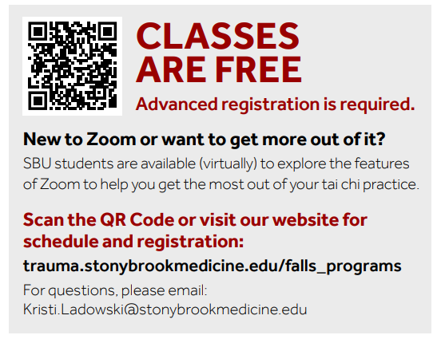
Thank You!
Contact: Kristi.Ladowski@stonybrookmedicine.edu
Notes:
So there it is. Thank you so much taking the time to listen to our on-demand session during the Aging in Action Conference. As delighted as we were to share about our experience, we are very much looking forward to hearing from all the other presenters over the next few days. Please feel free to reach out with any questions, comments, or especially if there is an interest in future collaboration. As we said earlier, we can’t do it alone. Partnerships are so important, and we look forward to connecting with more organizations. Take care everyone.

